Slide 1
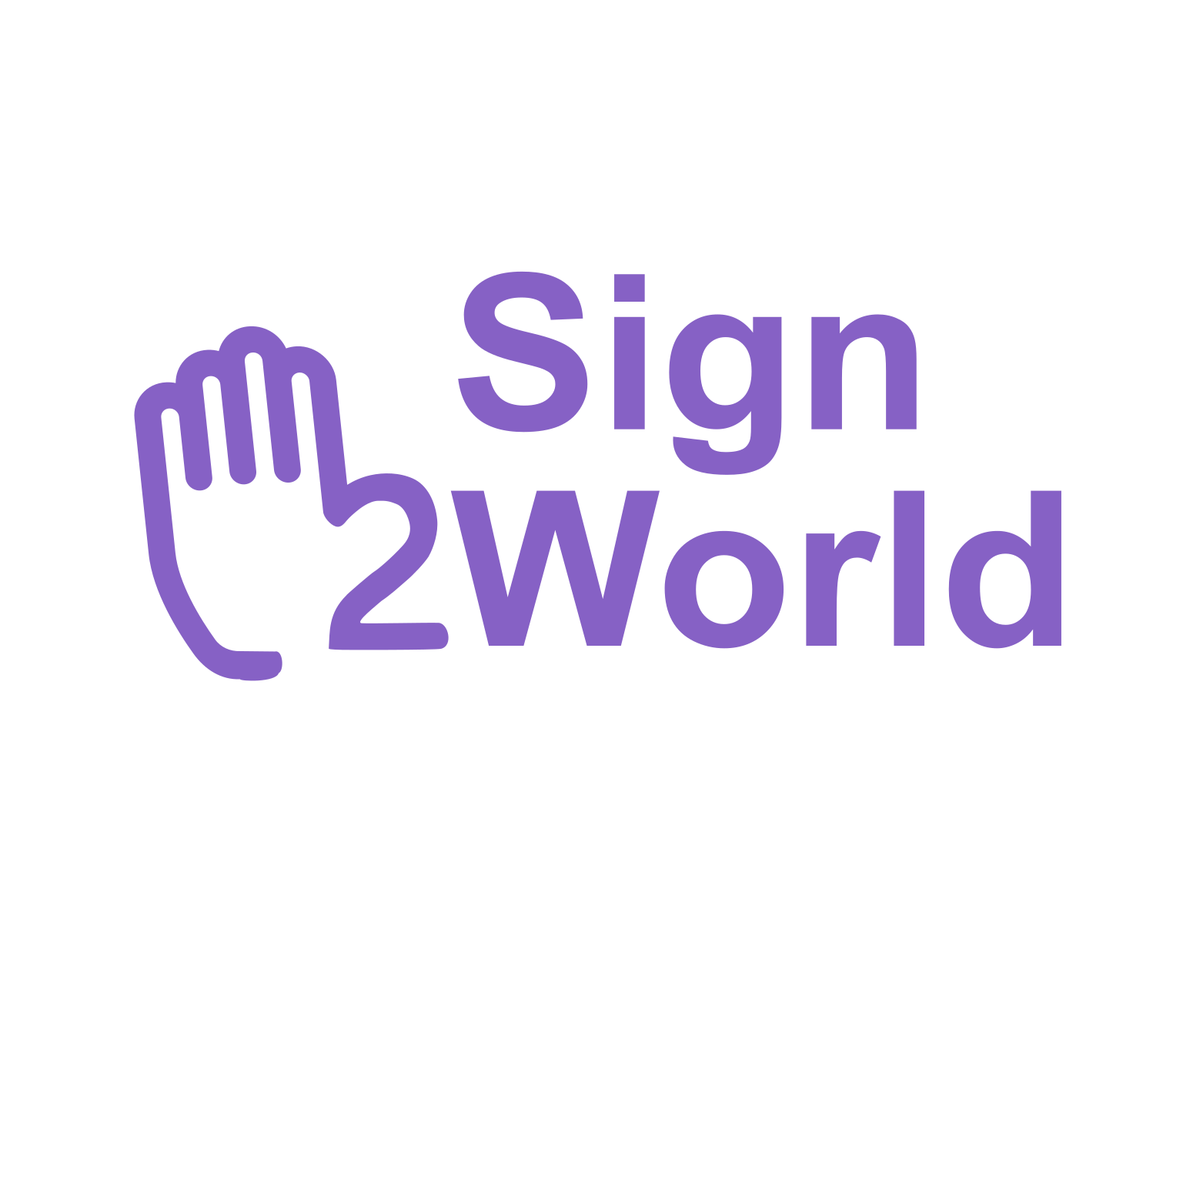
Intern Hackathon 2025
Bridging silence and speech, across multi language.
Notes:
AI is reshaping our world. Not in years. Not in months. Right now.
Making the impossible now possible. From natural language to visual understanding.
AI is redefining enterprise capability. From cost center to strategic differentiator.
From easy-to-use copilot experiences that come out-of-the-box to custom generative AI solutions, every organization is exploring how they can take advantage of AI.

Slide 2
Background and Statement

Slide 3
70 Million Use It. Almost No One Supports It.
<1%
<2%
Public websites are fully accessible
70M
Translation tools support sign language as input
people use sign language

Slide 4
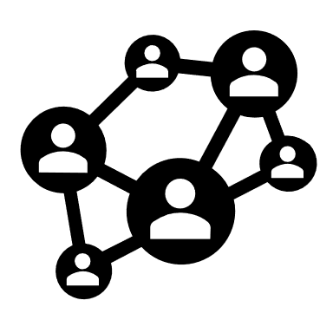
Problem Statement
Lack of sign language
translation tools
Tone and emotion are often lost in translation
Communication gap for
the deaf and
hard-of-hearing
Limited multilingual accessibility

Slide 5
Solution and Feasibility: Sign2World

Slide 6
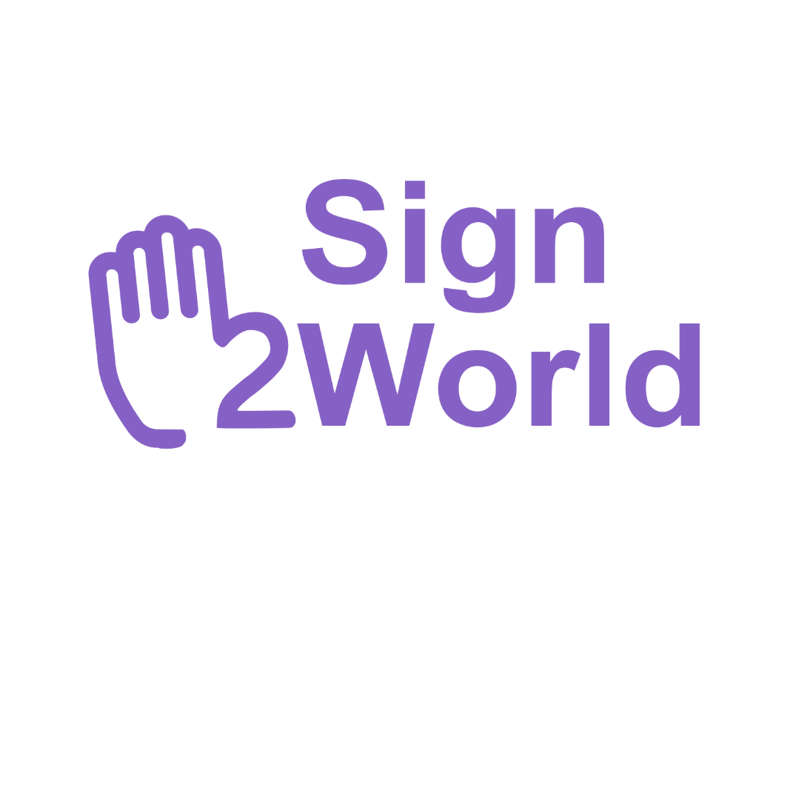
Bridging the Gap
How Sign2World Transforms Sign Language Accessibility
As-Is
To-Be
Lack of sign language translation tools
Designs to support sign language input
Tone and emotion are often lost in translation
Incorporates tone detection to preserve emotion
Limited multilingual accessibility
Supports 4 spoken languages
Communication gap for the deaf and hard-of-hearing
Transforms sign language into speech
Notes:
But we do know that people keep asking us “well, what about when I shouldn't use one or shouldn't use the other”.
Most of the time it does not matter which tool you use. In fact, if you're asking which tool to use, it's the wrong question.
There are a few edge cases like
- if you're trying to add AI to an application that already exists. Of course you will start in a code first world.
- If you're trying to edit or customize a pre-built M365 agent, you will do it in copilot studio.
But you could really use either. And our tooling is built in a way to give you the power of that choice.
We don’t expect any of our customers to have the sheer number technically skilled devs to transform/automate all your processes. So for those who aren’t technically skilled, building agents on a visual canvas with prebuilts and defaults in a natural language GUI makes a lot of sense to automate some of the simpler and standard processes. But where you are looking to build agents for proprietary business processes and have the investments to deploy technical resources towards it, the devs will chose to customize and control their individual services and fit this into their existing DevOps processes on Visual Studio or GitHub.

Slide 7






From input to output - What is our solution?
Input
Content recognition
Output
Emotion capture
Video
Target
Language
Translation
Audio in
target language
Speech generation

Slide 8
Technical Showcase

Slide 9
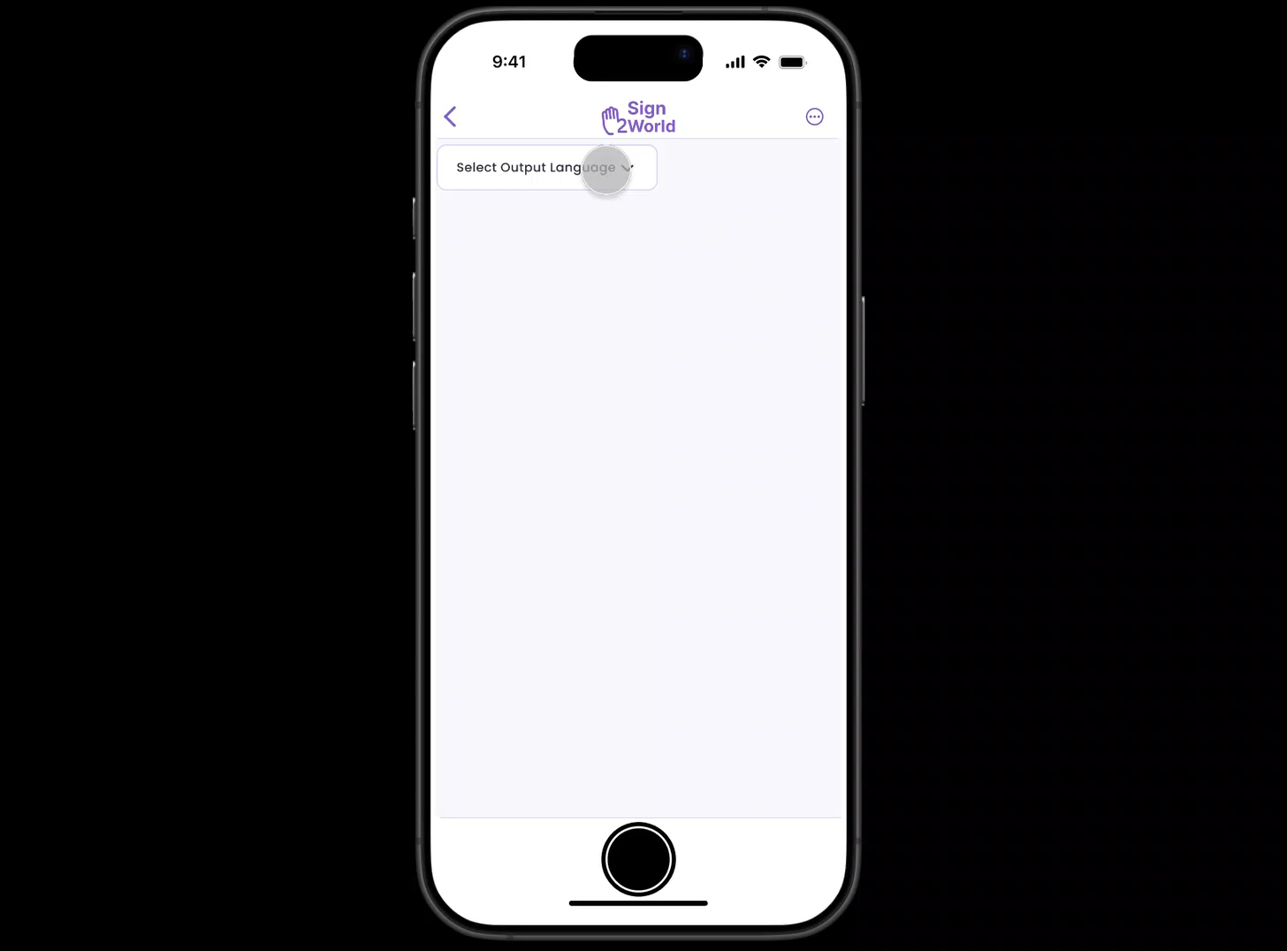
From Sign Language into Speech Translation

Slide 10
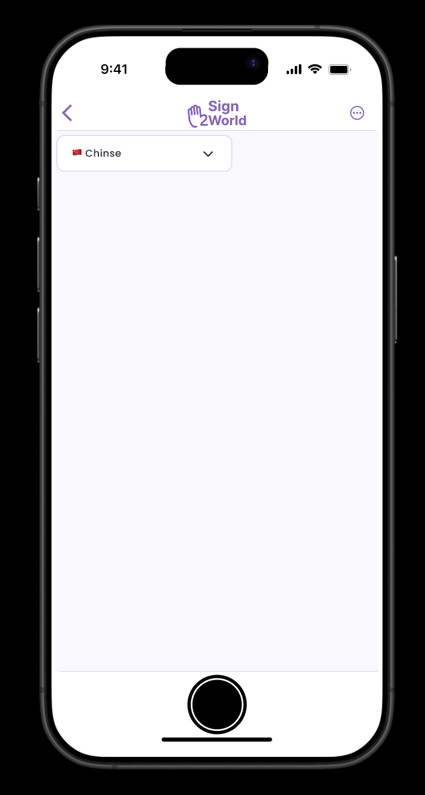
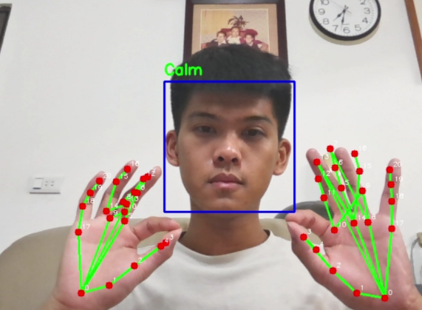


Emotional Speech Automation
Target:
Chinese
Emotion:
Calm

Slide 11
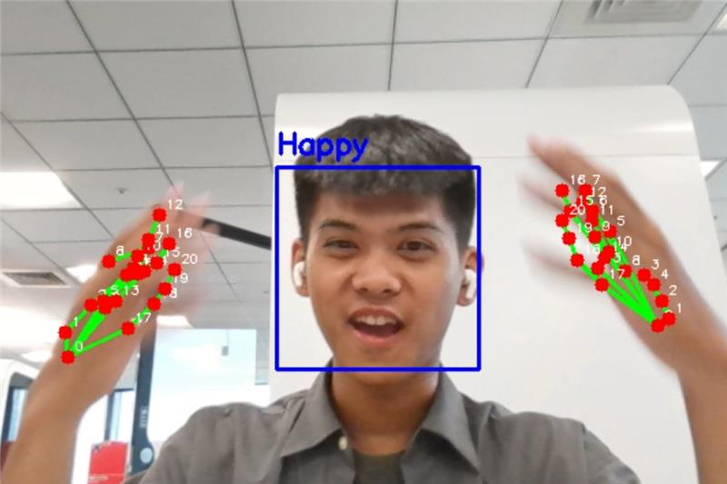
Emotional Speech Automation
Target:
Chinese
Emotion:
Happy

Slide 12
Sign2World: Technical Architecture
US Sign-Language
to Text
Content
Recognizing
Content transforming
Audio
Translating
1.a
Video
2
Text to Speech
3
Speech to Speech
4
Audio
Emotion
Capturing
Posture
to Emotion
Chinese
Dutch
German
Hindi
…
1.b
Target Language
Notes:
===== Skip this part if no time left =====
Let's walk through the Sign2World technical architecture, which transforms video input into audio output in a few key steps:
Video Input: The process begins with video input, where the system captures the video of someone using American Sign Language (ASL).
Content Recognition: The first step is content recognition, where the system converts ASL gestures into text. This allows the system to understand the message being conveyed.
Emotion Capturing: Simultaneously, the system captures the emotions expressed through gestures, ensuring that the emotional context is preserved.
Content Transformation: Next, the recognized text is transformed into speech. This step converts the textual content into spoken words.
Audio Translation: The speech is then translated from one language to another. The system supports multiple target languages, including Chinese, Dutch, German, Hindi, and more.
Audio Output: Finally, the translated speech is output as audio, providing the final result in the desired language.
===== Skip this part if no time left =====
This workflow showcases how Sign2World seamlessly converts video input into audio output, preserving both the content and emotional context throughout the process
(feel free to pause the video for detail research)

Slide 13


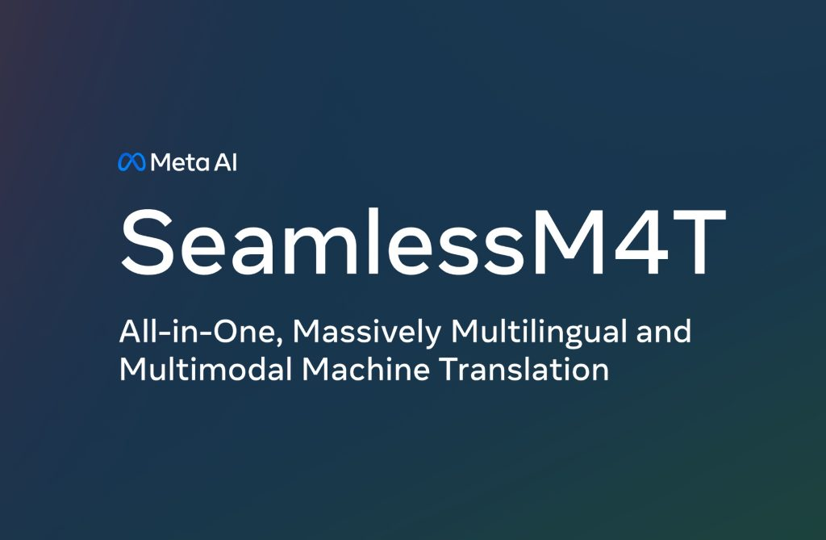


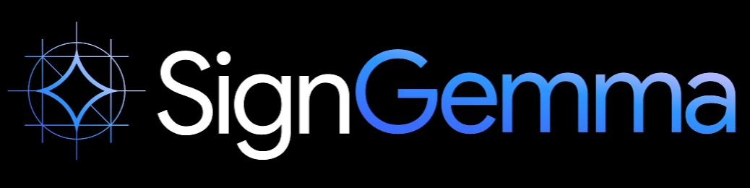
About Feasibility: Tech Stack
1
Posture to Text
Multi-lingual Translation With Tone
3
2
Notes:
===== Skip this part if no time left ===== From our preliminary research, currently:
Google SignGemma converts gestures into text, enabling seamless communication for sign language users.
Meta SeamlessM4T provides multilingual translation with intonation, ensuring accurate and expressive translations across languages. ===== Skip this part if no time left =====
This system can be realized through the integration of Google SignGemma and Meta Seamless M4T.
By stacking these technologies, we can create a seamless and efficient solution.
Microsoft can play a pivotal role as a service provider, combining these two models into the AI Foundry, acting as a partner to bring everyone together.

Slide 14
Impact, Value, and Market Potential

Slide 15
Impact Potential
Our Value Proposition
All-in-one AI pipeline: Sign recognition → Emotion detection → Multilingual translation → Human-like speech.
Adds emotional tone through facial expression analysis — a first in accessibility tech.
Modular and integrable into customer service, healthcare, education, and smart cities.
Increases access for hundreds of millions with communication disabilities.
Boosts customer satisfaction & inclusion metrics for businesses and public services.
Supports compliance with accessibility laws like ADA, WCAG, and EU Accessibility Act.
Notes:
Over 70 million deaf individuals use sign language as their primary communication method.
Yet less than 2% of public websites are fully accessible (W3C Web Accessibility Initiative, 2023).
Current translation tools ignore non-verbal emotion — critical for human communication.
Explore pilots with:
Inclusive schools & universities
Healthcare providers
Public service agencies

Slide 16






Market Opportunity
$50.6B
By 2030 (Assistive technology market)
$32B
By 2027 (Speech & language AI Market)
Growing Demand for multilingual
Notes:
Assistive technology market projected to reach $50.6B by 2030 (Allied Market Research).
Speech & language AI market to surpass $32B by 2027 (MarketsandMarkets).
Growing demand for multilingual, emotionally aware AI in B2G, B2B, and B2C segments.

Slide 17
What’s Next
Integrate Live Video Stream
Launch web/mobile app
Two-way communication
Speech-to-sign
Multi-National Sign Language
Inclusive schools & universities
Healthcare providers
Public service agencies
Notes:
Long-Term Vision Become the leading AI platform for non-verbal, inclusive, and emotion-aware communication, accessible to all — regardless of ability or language.

Slide 18
Empower every person and every organization on the planet to achieve more.
धरती पर हर व्यक्ति और हर संगठन को अधिक हासिल करने के लिए सशक्त बनाना।
Jede Person und jede Organisation auf der Welt befähigen, mehr zu erreichen.
Iedere persoon en elke organisatie op de planeet in staat stellen om meer te bereiken.
赋能地球上的每一个人与每一个组织，帮助他们达成更多目标
Notes:
Long-Term Vision Become the leading AI platform for non-verbal, inclusive, and emotion-aware communication, accessible to all — regardless of ability or language.

Slide 19
Thank you

